Slide 1

CVindicate
Final Presentation
Driving Companion
Group Members:
Name: Md. Tarbiar Swat ID # 1620918042
Name: Sraban M Roy ID # 1531051642
Name: Kaniz Fatema Etiee ID # 1620338042
Course Instructor:
Dr. Mohammad Ashrafuzzaman Khan

Slide 2

Problem analysis
What was the Problem?
The problem was to design an early warning system that will be able to detect objects and estimate distance from the object to the self-driving car. We trained our model with 2 objects:
Stop Sign
Demo Vehicle
Our custom model was able to detect both the vehicle and the stop sign successfully and estimate the distance from the multiple object as well.
Why was it difficult?
Detecting the stop sign and the demo vehicle in low light condition was a challenge. There was also an issue of reflective track surface which was creating an issue for our perspective view. Adjusting the camera at an appropriate angle (35°) and at an appropriate height (15cm) was mandatory in order to determine an accurate region of interest (ROI).

Slide 3
Problem analysis
How did we address those ?
We had to manage a low reflective matte black sticker. We also had to get innovative with the track pattern to avoid wrinkles so that there is minimum reflection. We also had to mount the Camera at a higher position with the help of supporting sticks so that there is a clear view of the track with the proper ROI (region of interest).
Related Works
Gathering up all the required hardware and listing them all together is vital for the completion of the project. Here we find the steps that are required to complete the project. The project requirements are deeply studied and cross checked with multiple documentation.
https://towardsdatascience.com/deeppicar-part-1-102e03c83f2c

Slide 4
Our Workflow
Our Approach
We followed a slave device and master device coronation to build our hardware model. The slave device is connected with the motor controller and the master device was fitted with a camera for real time object detection. With the assistance of a wiringPi library, it is connected with the data pins of the Arduino UNO and back to the Motor controllers. The entire mechanism helps to maintain the RPM of the motor controllers and it’s rotations.
The program is developed on a Raspbian OS. We have manually built OpenCV into the system and initially captured still images and later with a live camera with tracked ROI (Region of Interest) of the system in the front view window. We also captured Bird’sEye View for the perspective and Histogram View to show two lanes and lane center as well.
Collaboration
We have collaborated with our group members in Slack, Github, Google Meet, Team Viewer, VNC viewer and VNC Server.

Slide 5
Our Workflow
Our Contributions Individually
Name | Contributions
Md. Tarbiar Swat | Hardware: Robo Car Assembling, DC Motor and L298H Motor Controller configuration, Custom PCB, Arduino Configuration, Arduino forward Code, Raspberry Pi Assembling, SSH & VNC Server, Camera mount and setup, AI: Build OpenCV Manually, Set Build Paths and raspicam, realtime video and FPS adjustment, Testing segment, Lane finder Debugging, Lane center, wiringPi, code to capture dataset, negative datasets, Loading trained model into codebase (Car), Car Detection, Distance Estimation of car, Optimization
Sraban M Roy | Region of interest (ROI), Histogram, Configuring Digital Pins of Rpi, set connection to Arduino, Arduino Code all movement, Debugging, positive dataset capture, annotation, training model, Testing with XML
Kaniz Fatema Etiee | BGR to RGB, (ROI) debugging, Birds-eye View, Histogram Lane finder, Car movement information, Loading trained model into codebase (Stop sign), Stop Sign Detection, Distance Estimation of stop sign

Slide 6
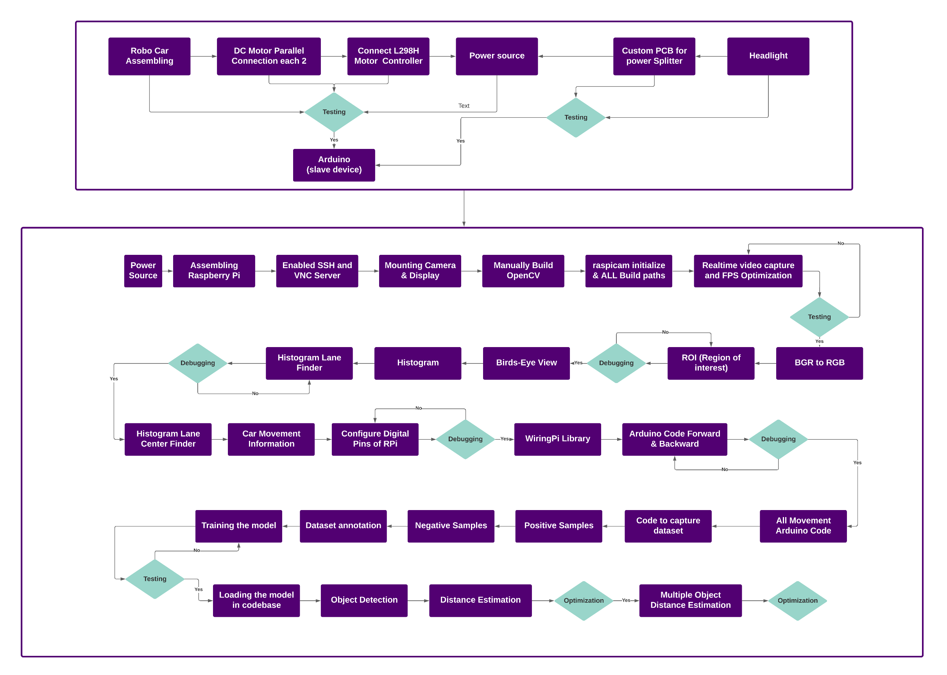
Our Workflow

Slide 7
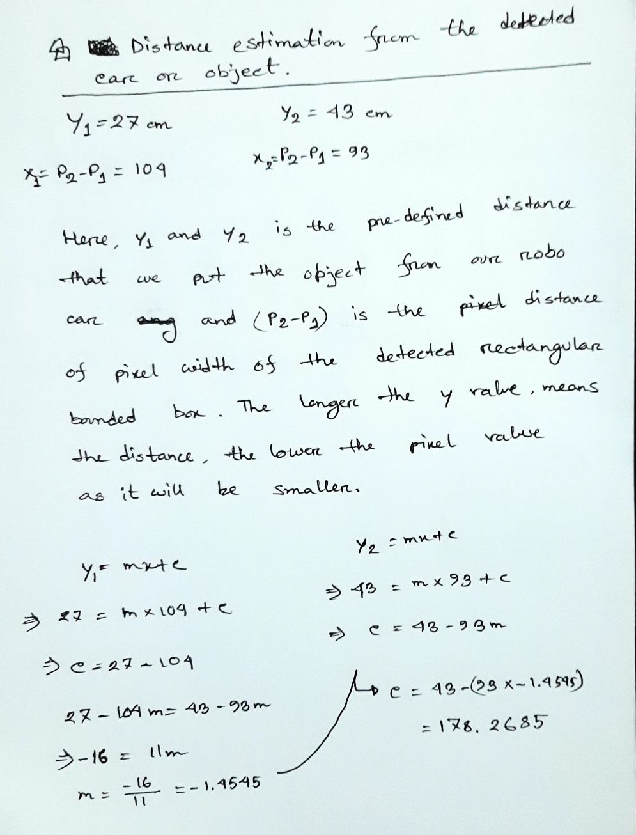
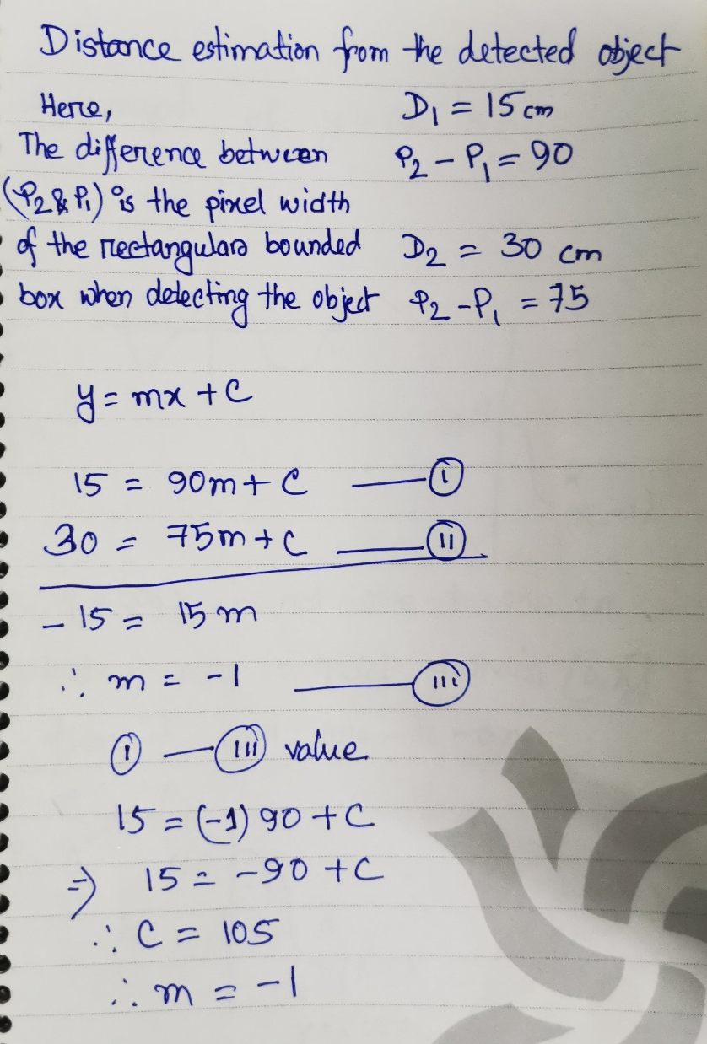
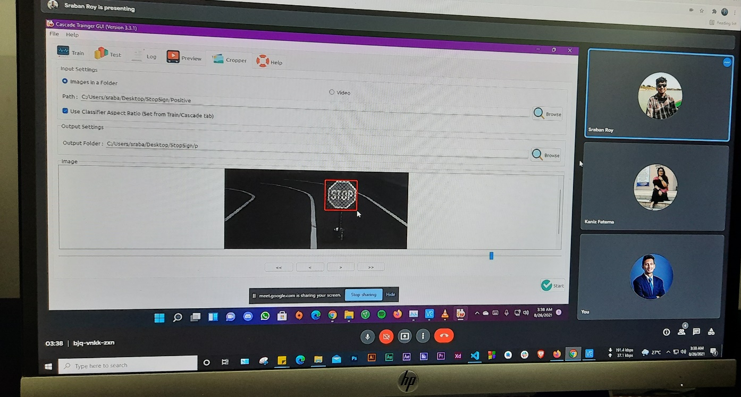
Distance Estimation and Dataset annotation

Slide 8
About CVindicate
Uniqueness
The most unique part of this project is the calculation of region of interest(ROI). We have also collected custom dataset to train our model, we have collected more than 1200 positive samples and annotated them individually. We have also implemented distance estimation of the detected objects even if there are multiple objects. We have also generated a histogram from our live camera module.
How we found this unique?
As per our discussion from the related works review, we have got into some new features in our project such as three different window view to see the device calibration and optimize it more. Most importantly we have coded the entire project using C++ that is even more faster to execute and our robo car is able to detect realtime upto 30 FPS or more. We have implemented two different window views to show the realtime object detection and distance estimation. We built OpenCV Manually in the Geany IDE. As much as we will use more data to train the model, our robo car will be more advanced.

Slide 9
About CVindicate
Teamwork
Teamwork was essential for a project of this caliber. We had to work consistently in coordination. Synchronization was essential since we had to push each of our work in github to maintain the order of tasks.
Tools we used
Software Level
Hardware Level
Geany IDE (Raspberry Pi)
VS Code
GitHub
GitBash
OpenCV
VNC Viewer & VNC Server
Arduino Nightly
Raspberry Pi 4 model B - 4 GB RAM
32GB SD card class 10
Heat Sink
Exhaust Fan
Display
HDMI cable
WiFi receiver dongle
1.3 MP Camera
USB Cable
Type-B & Type-C USB Cable
Arduino
USB 2.0 Cable Type A/B
2 part Robo Car chassis
4 DC Geared Motors
298H Dual DC Motor Controller
Soldering Iron
Glue Gun
Soldering wire
Jumper wire
Female Jumper IC
2 pin headers
Capacitors of 25V 1000uF
1k resistor
Switch
LEDs
5 volt power source
Ethernet cable
Connecting wires
A custom car model
Stop sign to detect

Slide 10

Result Analysis
What result did we get?
Our self-driving robo car successfully detects real time object and real time distance. It also detects multiple real time object and distance at a time. Also we implemented three different window view such as FrontView, Birds-Eye View & Histogram to evaluate it’s optimization and calibration accordingly & two different window to show the realtime object detection and distance estimation.

